Slide 1
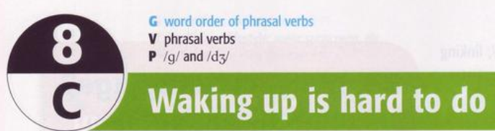

Slide 2
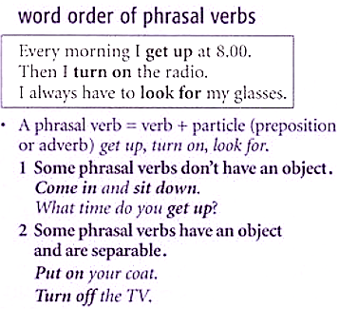
WORD ORDER OF PHRASAL VERBS

Slide 3
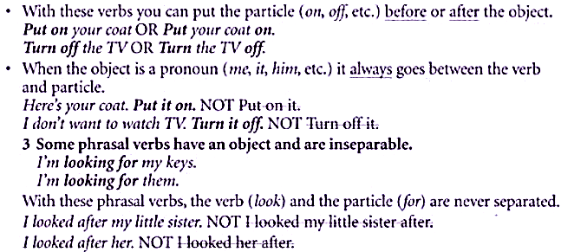

Slide 4
English Speaking
Phrasal Verbs for Speaking.

Slide 5
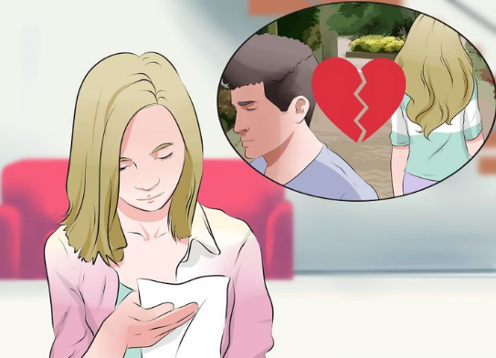
Examples of Phrasal verbs for Speaking
Break up:
To end a relationship with someone
I’m tired with my boyfriend, so I broke up with him.

Slide 6
Phrasal Verbs for Speaking
Turn around
Take off
Put out
Throw away
Look for
Try on
Pick up
Get on
Switch on
Run out of
Speak up
Break up

Slide 7

Speak up:
To speak louder.
Mike, can you please speak up. I can’t hear you.

Slide 8
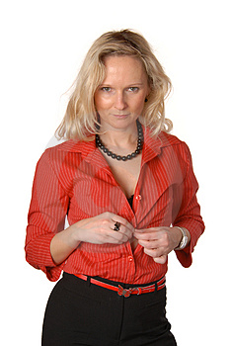
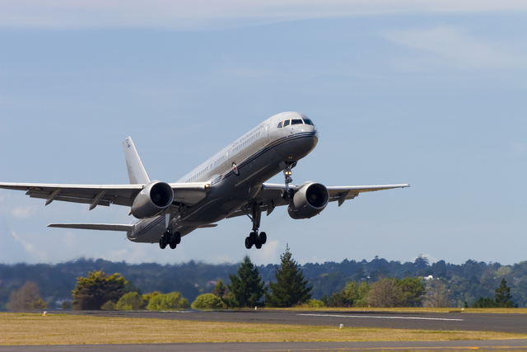
Take off: the moment when an aircraft leaves the ground and begins to fly:
Hey! Don’t take off your clothes in here! We have kids watching!
Fasten your seatbelts, the plane is taking off in a minute.

Slide 9

Put out: to do away with something.
Put out your cigarette for your own good!

Slide 10
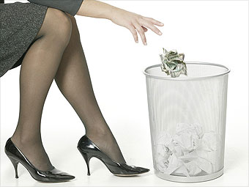
Throw away: to waste a something or opportunity:
I’m throwing my money away!

Slide 11
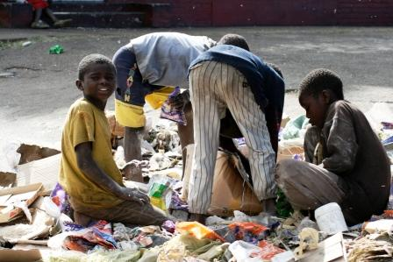
Look for: to try to notice or search for someone or something:
We’re looking for some food because we’re hungry!

Slide 12
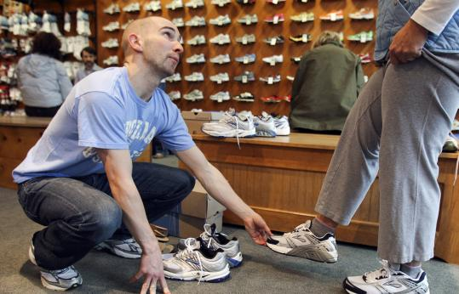
Try on: to put on a piece of clothing to see if it fits you or if you like it:
When you are buying for clothes or shoes, it’s a good idea to try them on to check if they fit you.

Slide 13
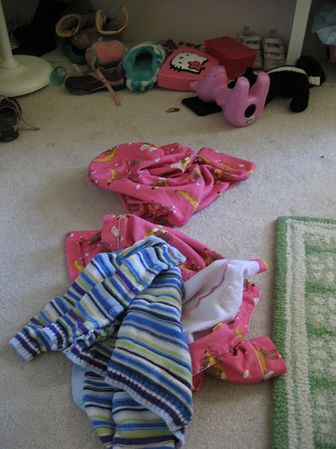
Pick up: to answer a phone or take something.
Your mom will be very angry if you don’t pick up all those things on your bedroom’s floor!

Slide 14
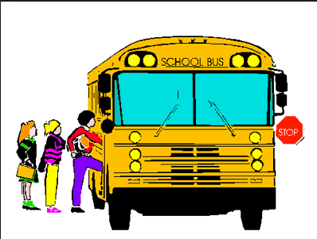
Get on(sth): to go onto a bus, train, aircraft, or boat:
Quick, get on the bus or you will have to walk home.

Slide 15

Switch on: to make a machine stop or start working by pressing a switch:
The teacher asked me to switch on the fan in the classroom.

Slide 16
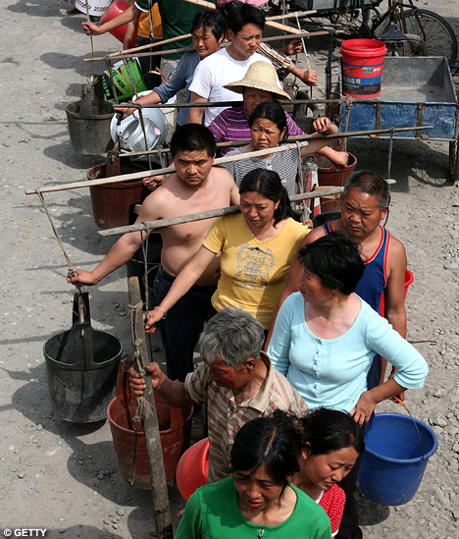
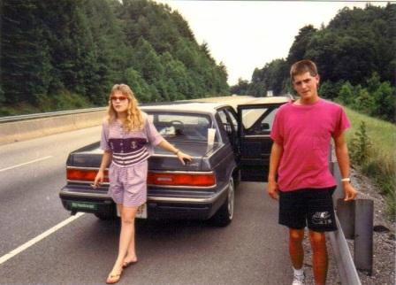
Run out of: not having enough of something.
These poor people run out of water every week because of the drought!
I can’t believe we run out of gas...!

Slide 17
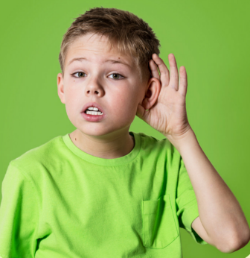
Phrasal verbs for speaking test.
A: Hi John, what time will you go to school?
B: Can you please ……………….? I can’t hear you.
a) speak on b) speak up c) speak through

Slide 18
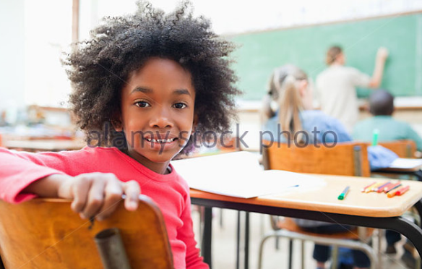
A: What do you think you are doing?
B: I’m ……………. to take a selfie in the classroom.
a) turning on b) looking around c) turning around

Slide 19
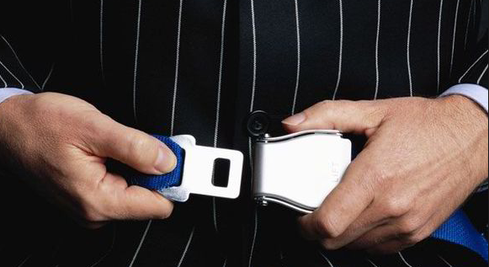
A: Fasting your seat belts, the flight is ………………… in a minute.
a) take out b) taking out c) taking off
B: Alright, thanks.

Slide 20
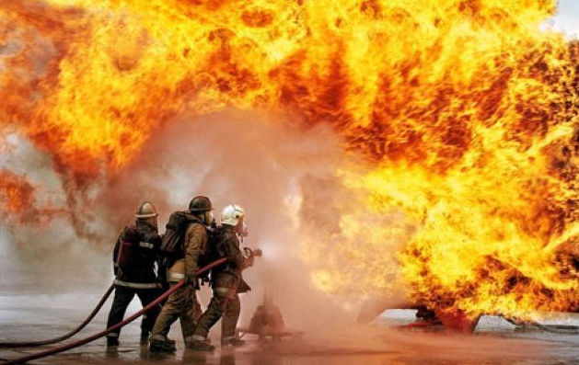
A: The firemen tried their best to ………… the fire.
a) put on b) put out c) put in
B: Wow! Good to hear that.

Slide 21

A: The students are …………... papers in the air. a) throwing away b) speaking up c) switching on
B: I think they are very happy.

Slide 22
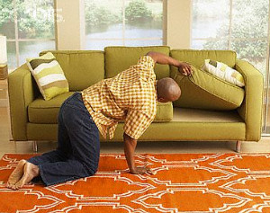
A: Daddy, why are you lifting up the things?
B: I’m ……………. my money, I don’t know where I put it. a) looking down b) looking up c) looking for

Slide 23
A: Please, can you …………. the shoes? If they are okay for you. a) put out b) try on c) take out
B: Okay. I think this one is good for me.

Slide 24
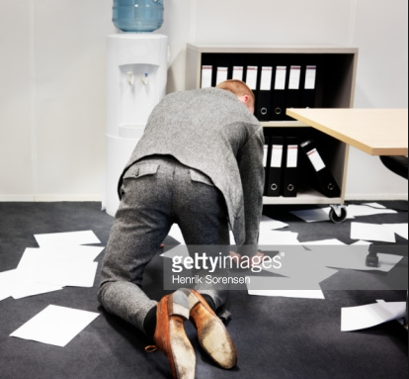
A: Mike, what are you doing on the floor?
B: I’m ……………. documents from the floor. a) turning around b) putting out c) picking up

Slide 25
A: Be fast and …………… the bus, if not you will be late. a) get on b) speak up c) try on
B: Ok mom.

Slide 26
A: The room is dark, kindly …………… the light. a) switch off b) pick up c) switch on
B: Alright, Mr. Ben.

Slide 27
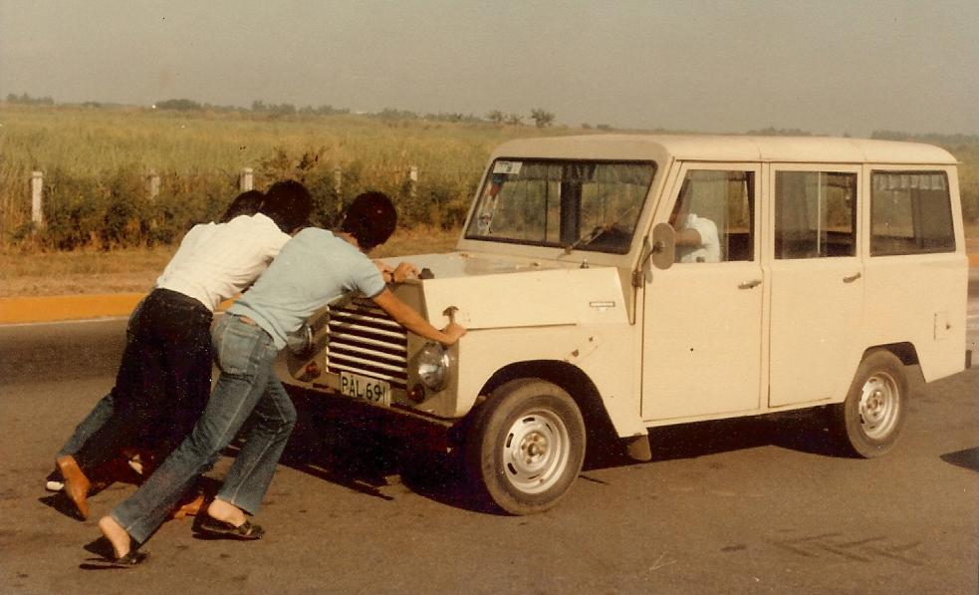
A: Why are they pushing the car?
B: I think they have ………………. gas. a) a lot of b) run out of c) turn on

Slide 28
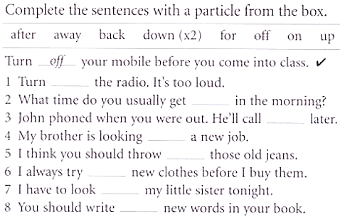
EXERCISE
1 down | 2 up | 3 back | 4 for
5 away | 6 on | 7 after | 8 down

Slide 29
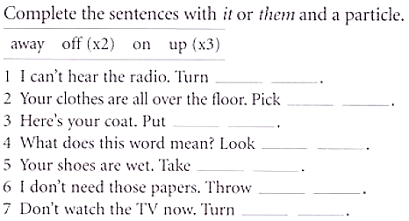
1 it up | 2 them up | 3 it on | 4 it up
5 them off | 6 them away | 7 it off

